Slide 1





Group Project
Presentation

Slide 2


Group Members
  Touch Mengleang
  Thy Navoan
  Trin Nary
  Thorn Thoueykakrona
  Tha Sivmey
  Tom Somary
  Theoun Somphors
  Vandy Samary
  That Sokmengly
  Thanak Mavin

Slide 3




ATM Cash withdrawal system
ATM Cash Withdrawal System is a program that simulates how an ATM allows customers to withdraw money from their bank accounts.
The System Management
The ATM Cash Withdrawal System consists of five main functions:
  Account Management: Check and manage customer balances.
  Cash Management: Monitor available ATM cash.
  Banknote Calculation: Calculate the required banknotes.
  Transaction Processing: Validate and process withdrawals.
  Balance Updating: Update the account and ATM balances.

Slide 4
ATM Cash withdrawal system
The Main Objective
The main objectives of this project are:
  Validate withdrawal amounts against the customer's account balance.
  Calculate the appropriate banknotes for each withdrawal.
  Ensure sufficient cash is available in the ATM.
  Update the account balance and ATM cash after successful transactions.
  Display transaction results and remaining balances.

Slide 5
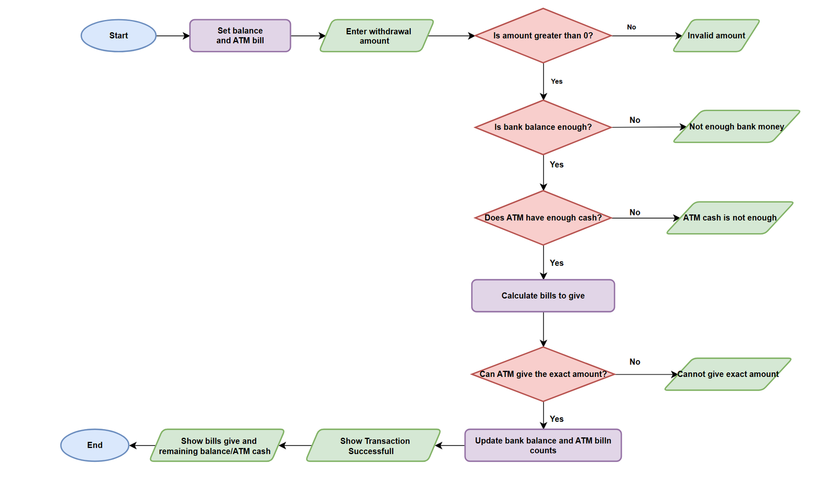
Flowchart

Slide 6
pratice code

Slide 7

Question Time

Slide 8

Thank Tou

